Slide 1
DATA ANAYLYTICS PROJECT - 1
Presented by – Group 7
Aman Maheshwari
Saloni Bhutada

Slide 2
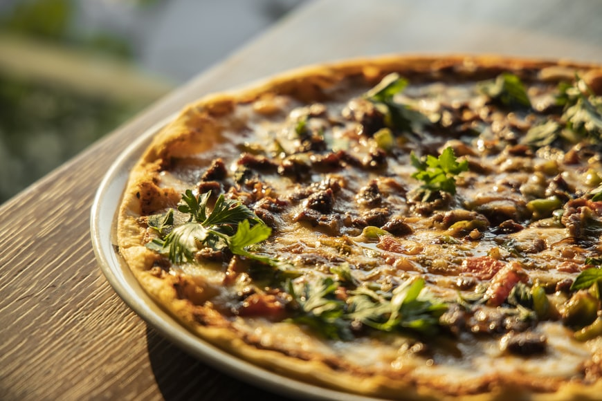
Zomato Restaurants Data Analysis

Slide 3

UNDERSTANDING THE PROBLEM
CHEAP &
GOOD
FOOD

Slide 4

1.4 million
About our DATASET
Number of listed restaurants on Zomato
We have dataset divided into two Tables –
Restaurant data & Country Codes
Shape of the Data
9551 X 21

Slide 5
VARIABLES
Restaurant Id: Unique id of every restaurant across various cities of the world • Restaurant Name: Name of the restaurant • Country Code: Country in which restaurant is located • City: City in which restaurant is located • Address: Address of the restaurant • Locality: Location in the city • Locality Verbose: Detailed description of the locality • Longitude: Longitude coordinate of the restaurant's location • Latitude: Latitude coordinate of the restaurant's location • Cuisines: Cuisines offered by the restaurant
• Average Cost for two: Cost for two people in different currencies 👫 • Currency: Currency of the country • Has Table booking: yes/no • Has Online delivery: yes/ no • Is delivering: yes/ no • Switch to order menu: yes/no • Price range: range of price of food • Aggregate Rating: Average rating out of 5 • Rating color: depending upon the average rating color • Rating text: text on the basis of rating of rating • Votes: Number of ratings casted by people

Slide 6
MAIN FEATURES FOR THIS Analysis
LOCATION
RATINGS
REVIEWS
AVERAGE COST OF TWO

Slide 7
PROCESS
DATA CLEANING & WRANGLING
VISUALIZATION
DATA COLLECTION
ANALYSIS
Data was gathered from Kaggle
We explore more about the data
Data is been cleaned/ modified to prepare it for further analysis
This is the last part of our analysis where all the findings are presented graphically

Slide 8



DATA CLEANING & WRANGLING
Data Cleaning
Data Joining
Discover
Checked shape, columns, summary, datatypes of the columns in the data
In this process, we initially checked for null values in the data and based on the outcome treated them
Joined both the tables on key column

Slide 9
Let us deep dive into some fantastic findings from this Data

Slide 10
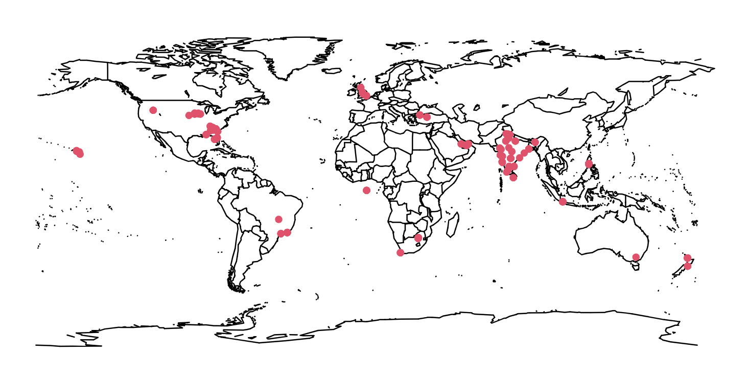
Business Question 1:
Countries to visit for some of the best restaurants?
Zomato’s data has primarily covered India, USA and few other countries, but we may deduce from this map that there are several top restaurants worth visiting in the United States, the United Kingdom, and India.
UK
India
USA

Slide 11
Business Question 2:
Preference of restaurants based
on votes in USA and UK?
As per this analysis we can infer that India has maximum top-rated restaurants based on customer’s reviews, next based on the data stands USA
Other countries like UK, Brazil, UAE just have limited count of top-rated restaurants
Count

Slide 12
Business Question 3:
Most Preferred
Analyzed types of restaurants located
in cities based on customer’s feedback?
We have grouped the restaurants based on customer’s voting, restaurants with highest voting's comes under most preferred category which holds about 36%.
Restaurants with average amount of votes holds the highest weightage of 41%
Least preferred category of restaurants holds 23% percentage in total number
Average
Restaurant
Least Preferred

Slide 13
USA
INDIA
Business Question 4:
Top Fast-Food Restaurants to try
According to the analysis, most liked fast-food eatery in United States - Shorts Burger and Shine followed by Green Truck Pub & in India we have Sagar Gaire Fast Food after which is Burger Factory.

Slide 14
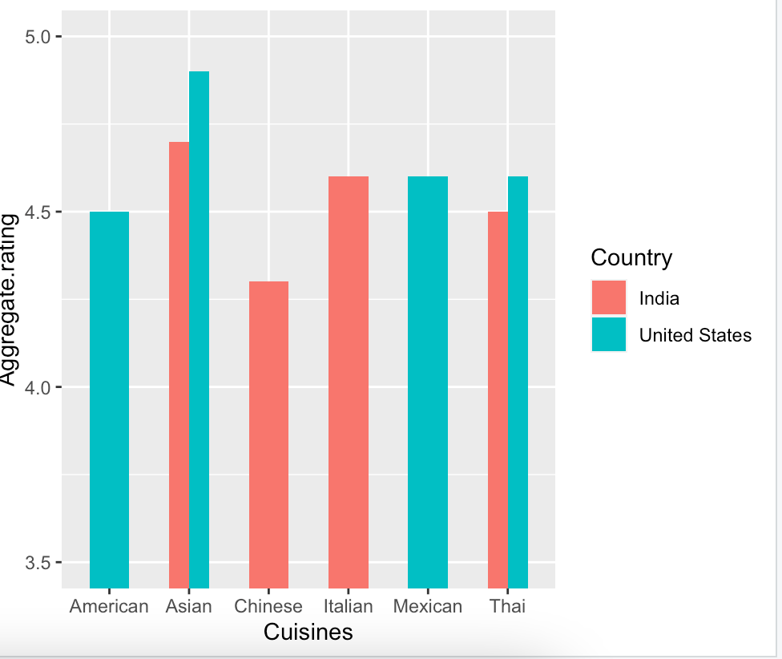
4.75
4.7
4.6
4.6
4.6
Business Question 5:
4.4
4.5
Analysis on some best specific cuisines restaurants to try
4.3
Based on Aggregate Rating –
Asian cuisines are most welcomed in both America and India followed by Italian, Mexican and Thai
Owning an Asian cuisine restaurant in America and India would never be a bad choice

Slide 15
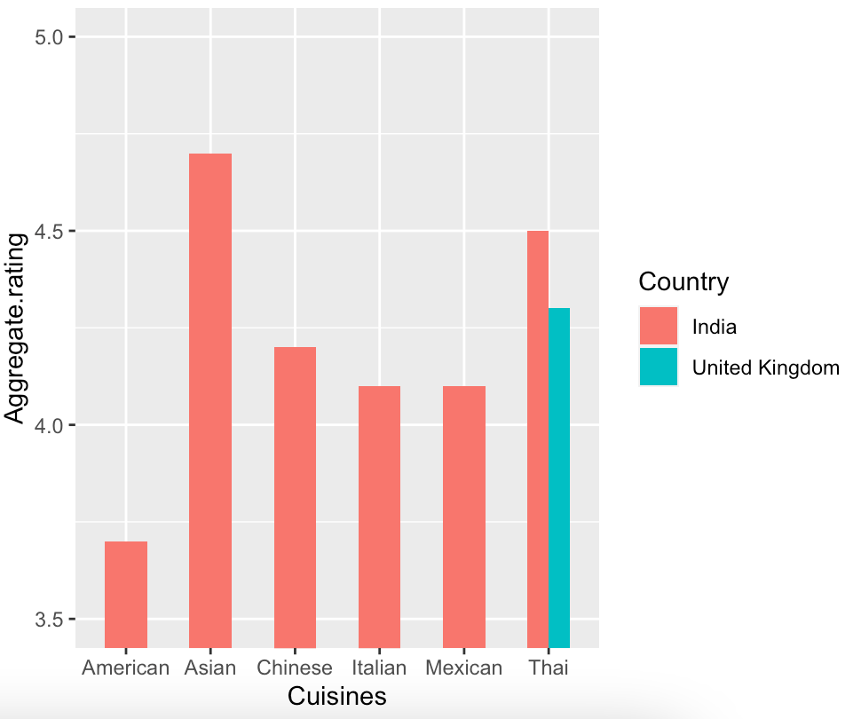
Business Question 6:
Some Best Specific Cuisines Restaurants
to try once in your lifetime
To be more specific with respect to whether the restaurant has table booking, based on location and ratings we chose some best fine dining restaurants.
UK zomato users show less interests in American, Asian, Chinese, Italian, and Mexican food, but they do like Thai food However, Thai food is more popular in UK

Slide 16
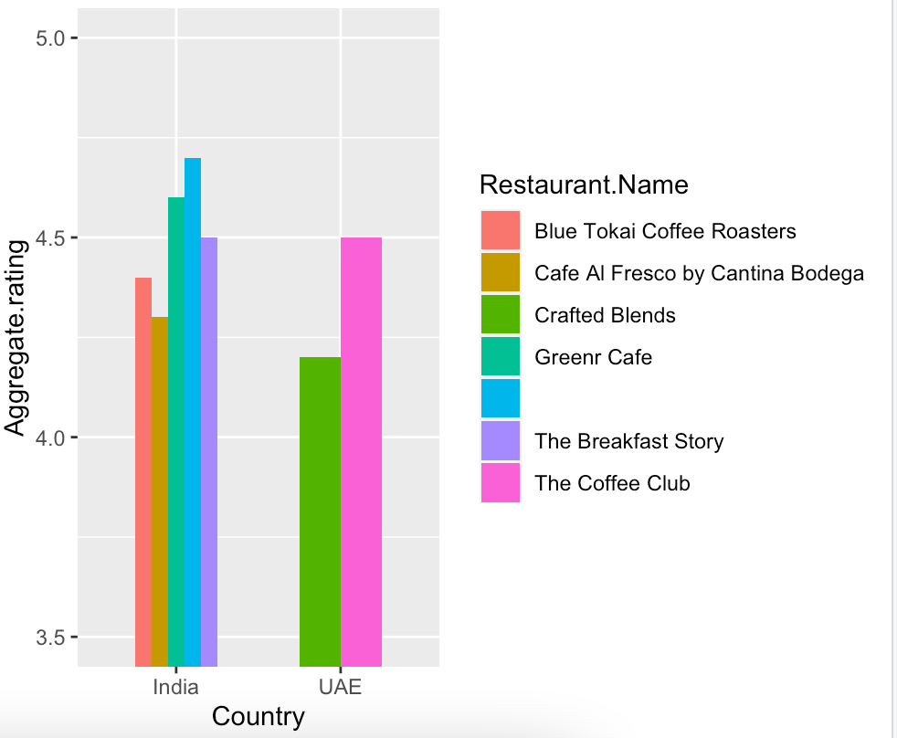
TOP CAFE TO HANGOUT IN INDIA AND UAE
Business Question 7:
Analyzing the top cafes from various cities
Based on this graph, we can conclude that India has a greater number of highest rates cafés comparatively
So, if you're looking for to visit India these are some cafes to go out with your date or hangout with friends

Slide 17
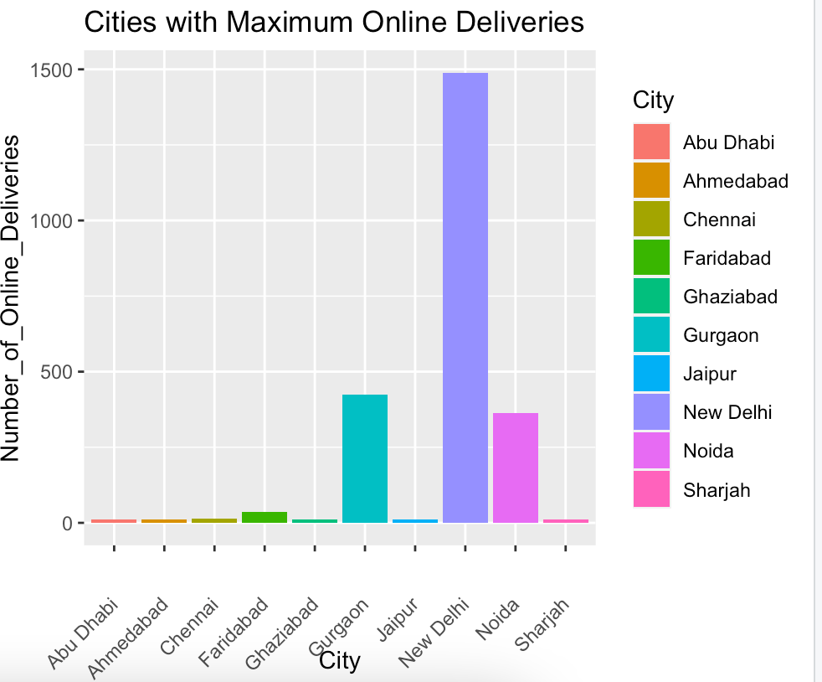
Business Question 8:
Cities with maximum online deliveries
The city with the most zomato online delivery is New Delhi.
If you want to launch an online delivery restaurant and work with Zomato, you should base your operation in New Delhi.

Slide 18
Conclusions:
India has the maximum number of the best rated restaurants.
USA, UK and UAE are the other few best rated countries with maximum number of restaurants after India
Asian cuisines are most welcomed in both America and India followed by Italian, Mexican and Thai
Key Areas :
DATA – It is more focused on the country of origin of the firm.
CUSTOMER FEEDBACK - This data is mostly dependent on customer feedback. For example, a restaurant located on the outskirts of town has fewer customers and hence fewer votes.

Slide 19
THANK YOU
References:
Kaggle Dataset
Tutorial Point for code reference

Slide 20


